Slide 1
Predicting Food Security with Machine Learning
Yujun Zhou, Kathy Baylis, Erin Lentz, Hope Michelson
Agricultural and Consumer Economics
University of Illinois
IPAD Seminar
10/17/2019
Notes:
Varun Kirshagar

Slide 2
Motivation - The Problem
Can build an early warning system of food security in areas where data are scarce and data collection is costly? (Hutchinson,1991)
We lack the ability to identify food insecure populations in time to intervene. Humanitarian response tends to trail the onset of food security crises.
Currently use the Integrated Food Security Phase Classification System (IPC)
The IPC has large data requirements and has been accused of political influence
Need to improve prediction of food security crises

Slide 3
Motivation - The Opportunity
Recent increase in available data related to food security, recent increase in available data on geography, weather, and market price for food. These data are often evaluated in isolation
Lentz et al. (2019) incorporate these data into a single predictive model of food security early warning
Emphasis on the accurately predicting those villages that face a potential threat of hunger.
As with any rare event, one challenge with predicting food insecurity is the low rate of severe food insecurity in the baseline data.
Use machine learning and data techniques to address this imbalance to capture a higher fraction of these rare events.

Slide 4
Research Question
Can build an early warning system of food security in areas where data are scarce and data collection is costly? (Hutchinson,1991)
Emphasis on detecting when and where food insecurity happens
A framework that is automatically updated, generalizable, scalable and cost-effective

Slide 5
Summary
Build ML models to predict cluster-level food security status for targeting, aid purposes in times of food shortage
Use LSMS data for Malawi, Tanzania and Uganda as ground truth
Use market price of food staples, weather shocks in growing seasons, and geospatial features around clusters to predict potential food security challenges
Use data techniques (sampling, cross-validation, data segmentation) to improve prediction performance
Correctly categorize 30-60 % of the most food insecure categories when the baseline model using a logistic regression cannot detect any

Slide 6
Literature Review
Nightlights data to predict village-level poverty (asset index) (Chen and Nordhaus 2011; Henderson et al. 2012), noisy and lack of variation in certain areas
Mobile phone data (Blumenstock et al., 2015; Steele et al., 2017) hard to scale
Satellite imagery (Engstrom et al., 2017; Donaldson and Storeygard, 2016) - lack of labeled data to extract structured information
Combining night-lights and satellite imagery in a CNN model (up to 70% accuracy) (Jean et al., 2016; Babenko et al. 2017)
Reliance on satellite imagery and Nightlights data (Head et al. 2017)
works in some areas better than others (SSA; Nepal and Haiti are problematic)
does not capture changes in poverty over time
does not do so well with other development metrics: nutrition, health

Slide 7
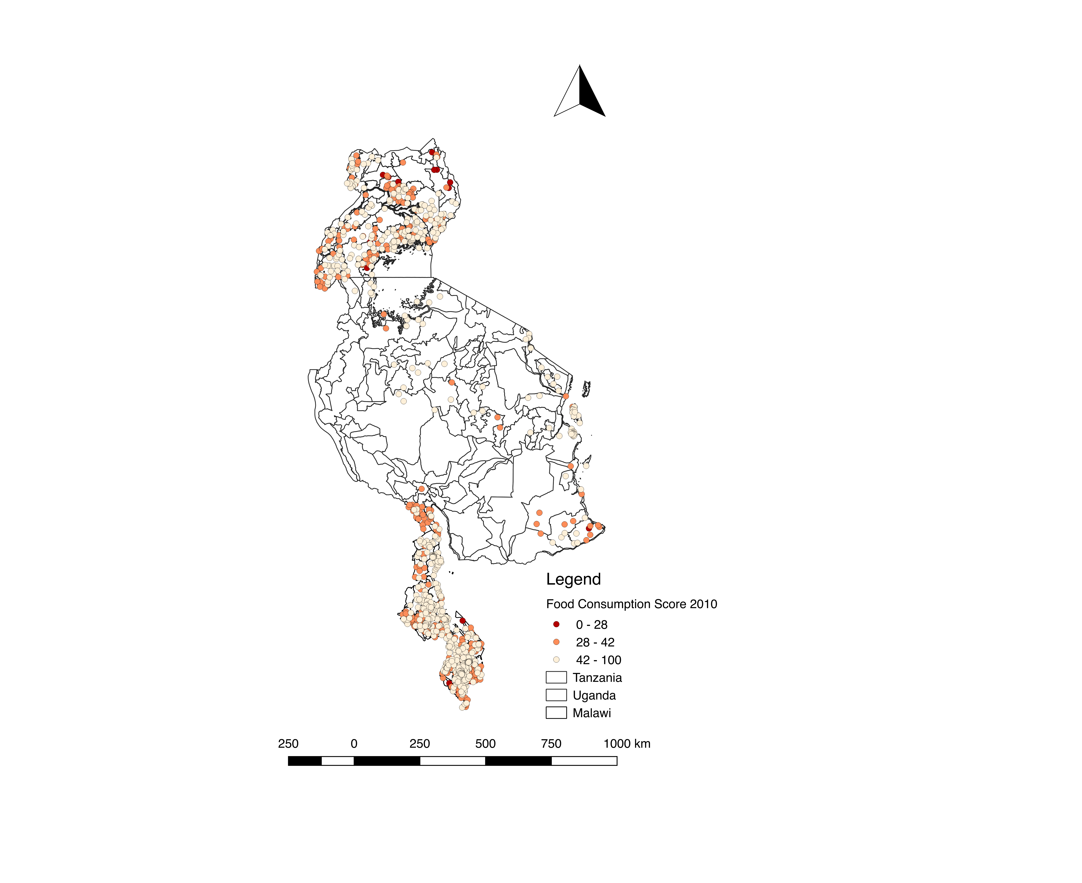
Data
LSMS
survey
Ground truth data in Uganda/Tanzania/Malawi
Household assets, demographics, geolocation of clusters
Prices
major grain prices (maize, rice, nuts, beans etc.) in main agricultural markets prices, collectedly monthly
Lagged one month before the survey time
Weather
Precipitation/temperature from remote sensing are relevant to agricultural production
From the previous growing season
Three different rounds each with broad spatial coverage
Distance to roads and markets reflects access to market and information
Zhou, Baylis, Lentz, and Michelson

Slide 8
Framework
HH Survey
Processing
Matching
Transforming
Error
Analysis
Model Tuning
Model
Deploy & Update
Weather
Price
Environmental
ML models

Slide 9
Framework
Raw data
Temperature
Features
Train/Test Splits
Models
Baseline
Cross-validation
Precipitation
Grain prices
Geospatial coordinates of markets, major cities, villages
Household surveys
Labels
Categorical
Measurement
Interpretation
Distance from village to nearest major roads
ML models
Sampling
Segmentation
Error Analysis
Average roof type of the village
Length of dry spell in the last growing season
Maize price in previous month in the nearest market

Slide 10
Decisions, decisions
Categorical versus continuous prediction
If categorical, how do we address rare events?
How do we split the data?
What algorithm do we use?

Slide 11
Categorical vs Continuous?
Focus on the categorical prediction for the given cutoffs of each food security measures.
Recall rate of the insecure villages is more important than the over all accuracy.
Typically, classifiers are more sensitive to detecting the majority class and less sensitive to the minority class.
Close to the actual policy scenarios where policy makers need to locate places with most insecure households.
Apply the down sampling, over sampling, and synthetic data techniques to force the model to learn about the tail of the distribution

Slide 12
Methodology: Detecting Rare but Relevant households
FCS
HDDS
rCSI

Slide 13
Methodology:
Down sampling, Over sampling and Synthetic data
Notes:
SMOTE is an over-sampling method. What it does is, it creates synthetic (not duplicate) samples of the minority class. Hence making the minority class equal to the majority class. SMOTE does this by selecting similar records and altering that record one column at a time by a random amount within the difference to the neighbouring records.

Slide 14
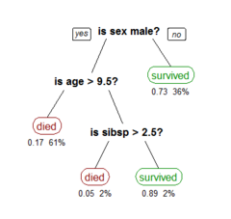
Methodology: Classification Algorithms
For structured data like ours (unlike text or pure image), tree-based methods are popular.
Classification Tree (base learner)
Random Forest ( parallel )
Gradient Boosting (sequential)

Slide 15
Recall (are we getting all the insecure households ?)
Precision (are we mistakenly categorizing secure households as insecure?)
F-1 score (balance recall and precision)
Overall categorical accuracy
Methodology: Result Measurements

Slide 16
Methodology: Baseline Model
Logistic Regression
Data split: year split (cross-validated)
Data segmentation: by country
Down/over sampling: None
Variable groups:
Asset: cellphone ownership, floor/roof material, asset index
Location: elevation, distance to road, urban/rural
Market : food price, market thinness
Weather: dry spells, average temperature and rain

Slide 17
Methodology: Cross-validation
Rare events of food insecurity tend to vary a lot year by year, i.e. 1 or 2 cases in a good year vs over 50 cases in a bad year
Use any two years as training data to predict the third year
Average out the performance after cross-validation to get more stable and trustworthy result

Slide 18
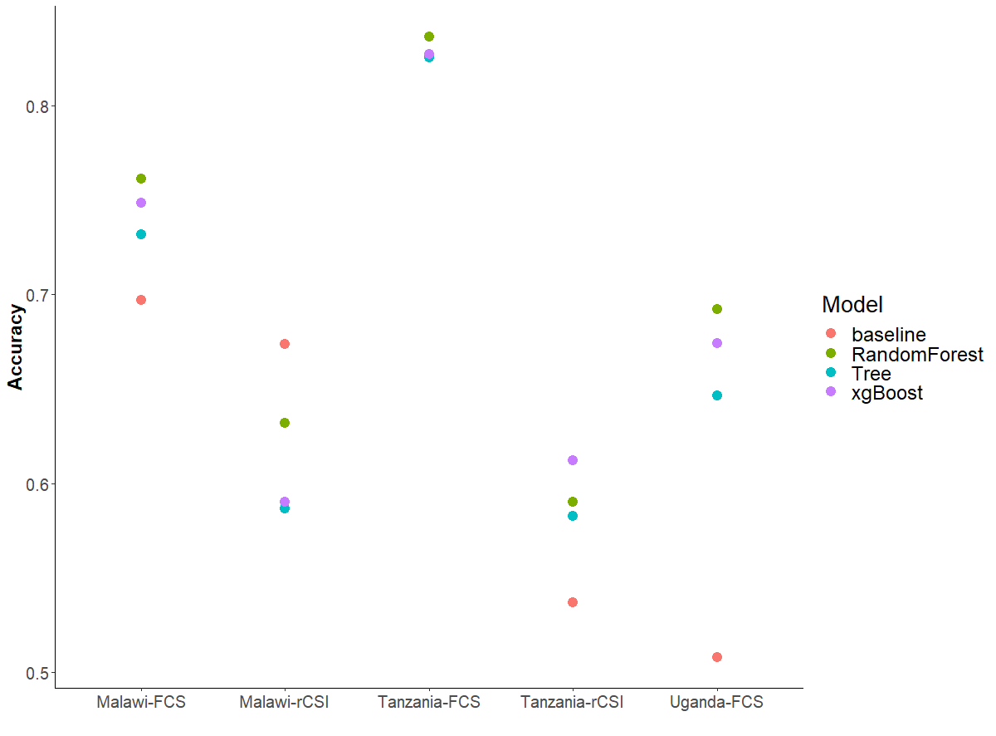
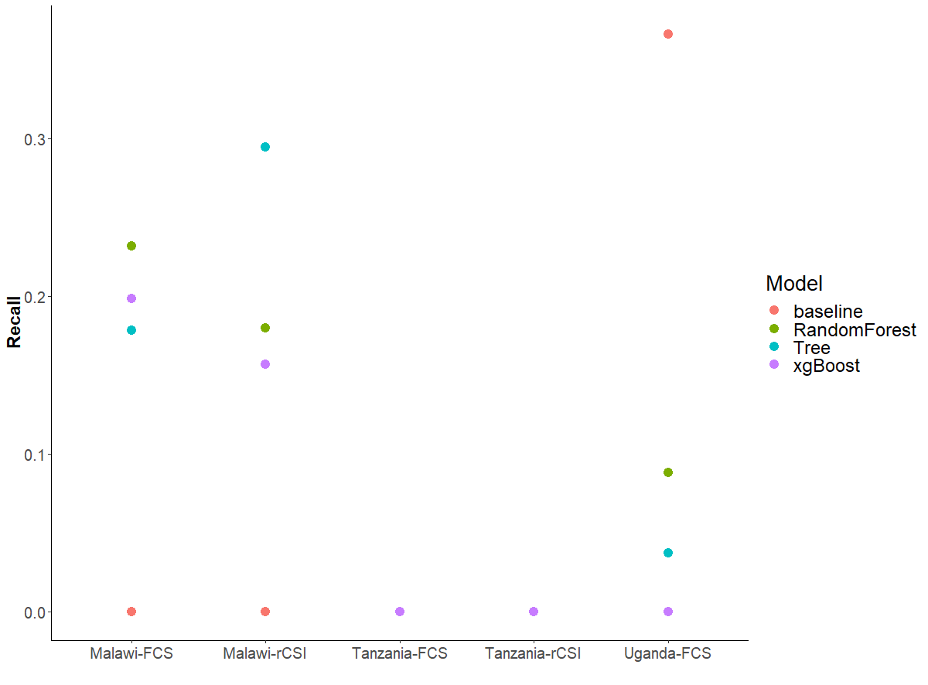
Baseline vs ML algorithms (year split)
Notes:
Need to have a column on overall splits

Slide 19
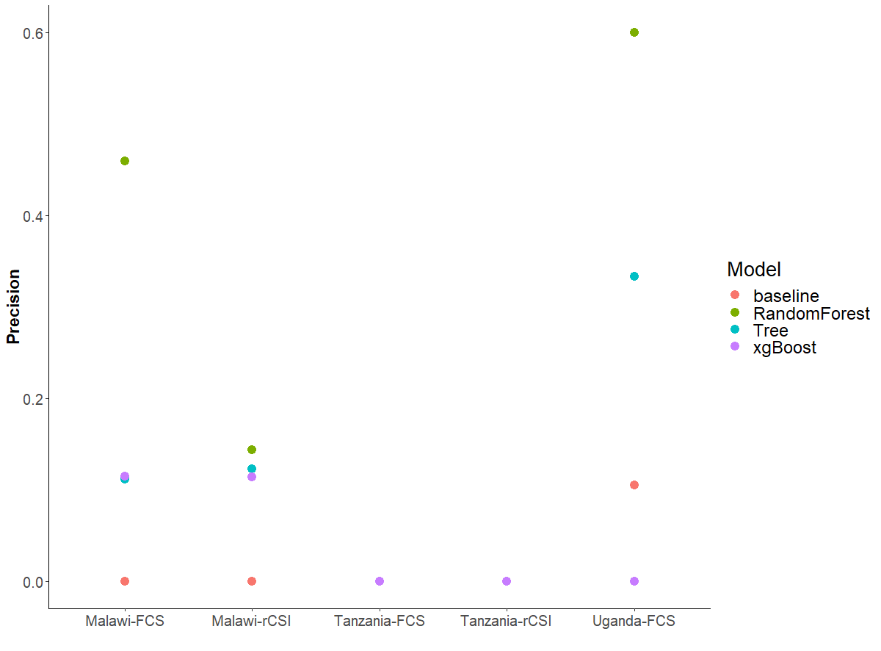
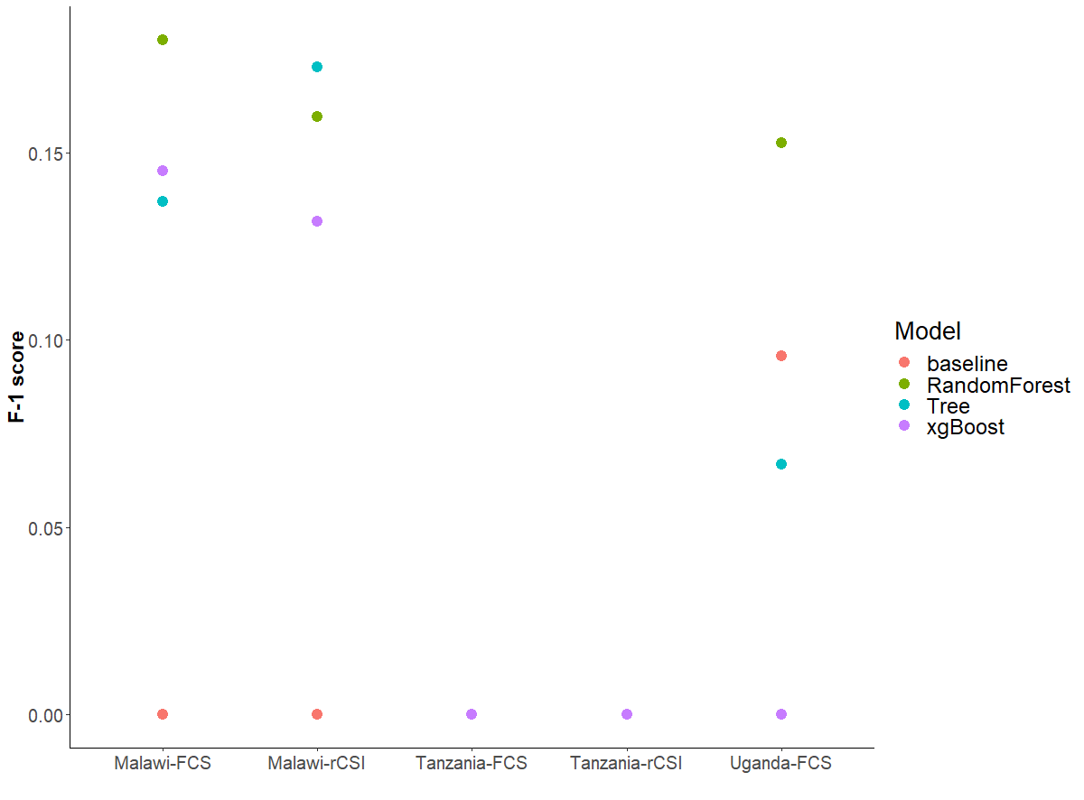

Slide 20
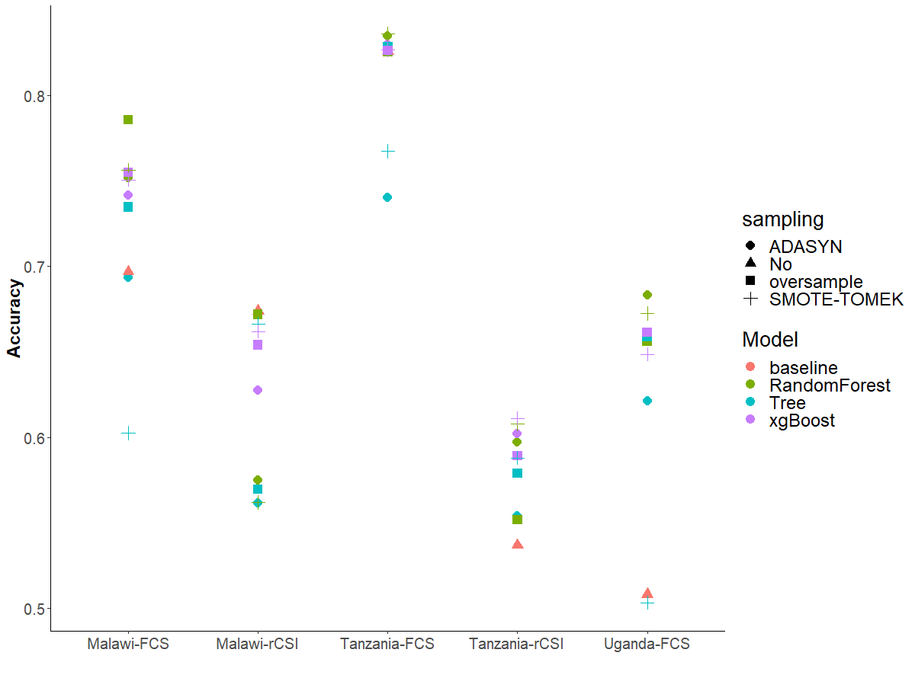
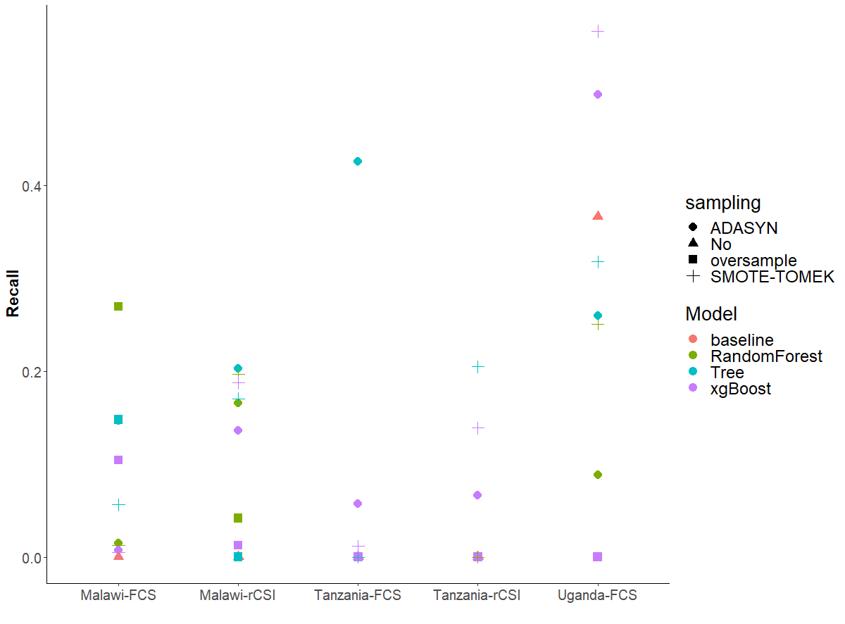
Baseline vs ML algorithms with down/over sample technique

Slide 21
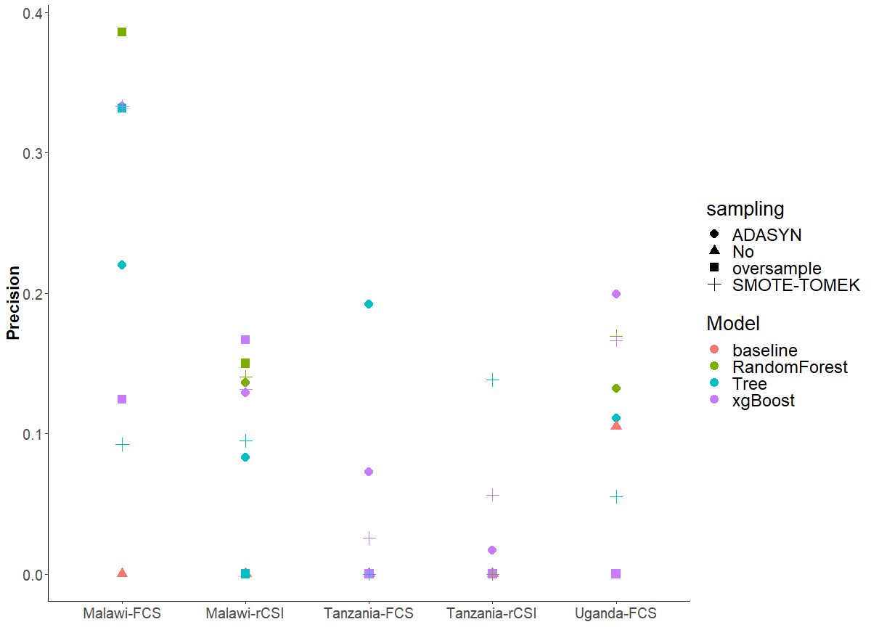
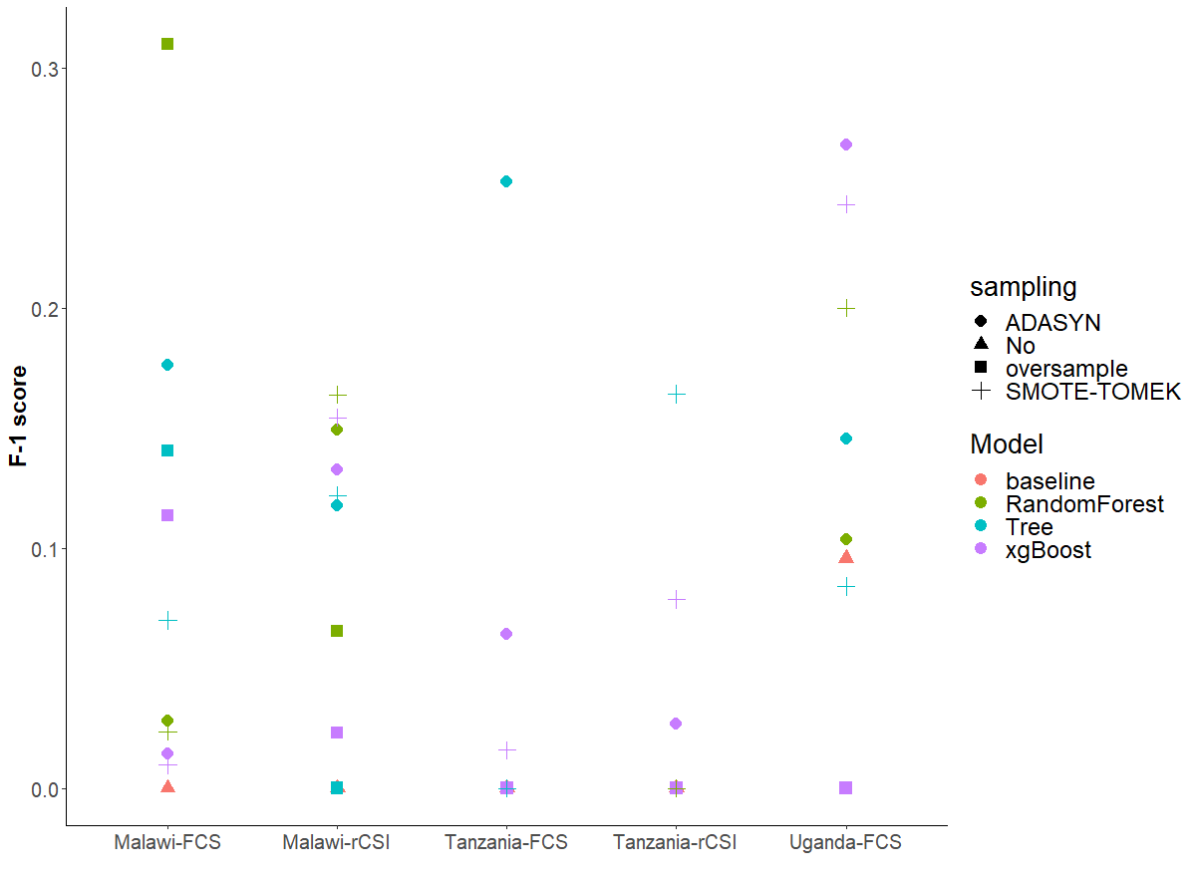

Slide 22
Binary cutoff (safe vs not)
Receiver Operating Characteristic (ROC) curve
Compared to three/four category cutoffs:
Coarser classification of clusters that may require assistance
ROC curve to demonstrate the models’ ability to classify the unsafe category accurately
more data in the minority class to make the models work better
The curve plots the true positive rate (TPR) or recall against the false positive rate (FPR) at different values of threshold, where the threshold is defined as the probability cutoff of treating an instance as 1.
The false-positive rate measures the cases we have a “false alarm.”
The area under the ROC curve (AUC) is a universal statistic for model comparison in the machine learning practices.

Slide 23
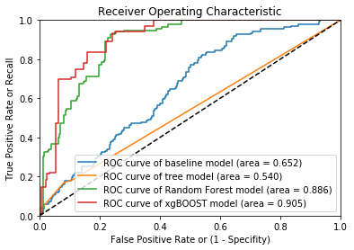
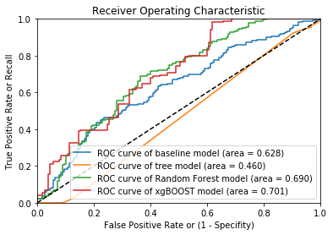
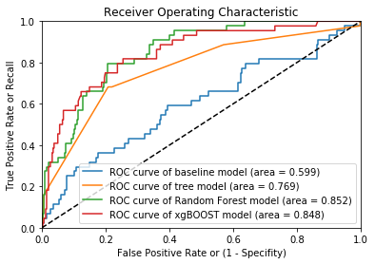
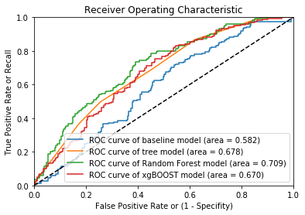
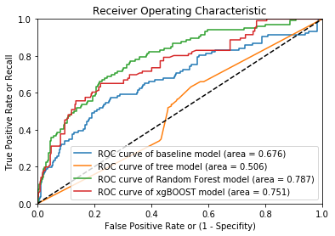

Slide 24
Feature importance
Cellphone <0.53？
Mean temp
< 24.6 ？
Natural Roof percent<0.3?
Distance to admarc road< 2km？
Asset index< -0.058?
Bean price < 47.43?
Cellphone <0.53？
Mean temp
< 24.6 ？
Natural Roof percent<0.3?
Total rain <779？
Floodmax rain < 832.6?
Bean price < 47.43?
Original
Oversample

Slide 25
Random Forest Feature importance
Variable | Importance | Std
number_celphones | 0.12 | 0.11
cell_phone | 0.09 | 0.10
roof_natural | 0.05 | 0.06
asset_index | 0.04 | 0.03
FS_month | 0.04 | 0.02
floor_dirt_sand_dung | 0.03 | 0.06
dist_popcenter | 0.03 | 0.02
dist_road | 0.03 | 0.02
percent_ag | 0.03 | 0.02
maxdaysnorain | 0.03 | 0.02
lhz_beans_price | 0.03 | 0.02
dist_admarc | 0.03 | 0.02
floodmax | 0.02 | 0.02
clust_maize_mktthin | 0.02 | 0.02
Variable | Importance | Std
roof_natural | 0.11 | 0.07
cell_phone | 0.09 | 0.10
floor_dirt_sand_dung | 0.08 | 0.04
number_celphones | 0.05 | 0.10
roof_iron | 0.04 | 0.06
day1rain | 0.04 | 0.01
clust_beans_price | 0.04 | 0.01
lhz_maxdaysnorain | 0.03 | 0.02
lhz_nuts_mktthin | 0.03 | 0.01
asset_index | 0.03 | 0.02
household_head_age | 0.03 | 0.02
clust_maize_price | 0.03 | 0.02
dist_road | 0.03 | 0.02
Original
Oversample

Slide 26
XGBOOST Feature importance
Variable | Importance
roof_natural | 0.11
cell_phone | 0.09
floor_dirt_sand_dung | 0.08
number_celphones | 0.05
roof_iron | 0.04
day1rain | 0.04
clust_beans_price | 0.04
lhz_maxdaysnorain | 0.03
lhz_nuts_mktthin | 0.03
asset_index | 0.03
Household_head_age | 0.03
clust_maize_price | 0.03
dist_road | 0.03
clust_maize_mktthin | 0.02
Variable | Importance
Cellphone | 0.11
num_cell | 0.09
floor_dirt_sand_dung | 0.07
roof_iron | 0.06
asset_index | 0.06
dist_popcenter | 0.06
lhz_day1rain | 0.06
lhz_maize_price | 0.06
dist_road | 0.06
Household_head_age | 0.05
region19 | 0.05
percent_ag | 0.05
region9 | 0.05
Variable | Importance
num_cellphones | 0.15
roof_iron | 0.15
region3 | 0.15
dist_road | 0.12
floor_dirt_sand_dung | 0.12
roof_natural | 0.12
Cellphone | 0.12
floodmax | 0.08
Malawi FCS
Tanzania FCS
Uganda FCS

Slide 27
Methodology: Data Split
Split by year, by region or random
For different application purposes and different data structures

Slide 28
Methodology: Data Segmentation
By country
Entire dataset of three countries
By urban and rural
4. Auto-segmentation by training a shallow tree in each country based on observables
Original data set
By Country
Malawi
Tanzania
Uganda
Original data set
Tree
Node 1
Node 2
Node 3
Node 4

Slide 29
Methodology: Generalization and Update
Model generalization:
what happens when we directly apply models trained on one country/region to predict another
Model deploy and update:
compare the results of using one year, with a dynamic process of constantly updating model with new survey data

Slide 30
Error analysis
Model generalization:
what happens when we directly apply models trained on one country/region to predict another
Model deploy and update:
compare the results of using one year, with a dynamic process of constantly updating model with new survey data

Slide 31
Future Steps:
Variables that explains the variations, especially poor households
Market variables, which crop and where
Weather variables: dry spell, rainfall related signs
Assets, cellphone ownership

Slide 32
Conclusions
Combined with data techniques, machine learning methods not only improve prediction accuracy in general, but particularly on households that are vulnerable to food price shocks.
An automated, updated and scalable food security system based on publicly available data, advanced data techniques can assist the work of food aid and humanitarian responses in a timely, transparent, and efficient fashion.

Slide 33
Thank you !

